Slide 1
Applying Science of Team Science Research to Undergraduate and Graduate Education
Maura Borrego
Mechanical Engineering and Curriculum & Instruction

Slide 2
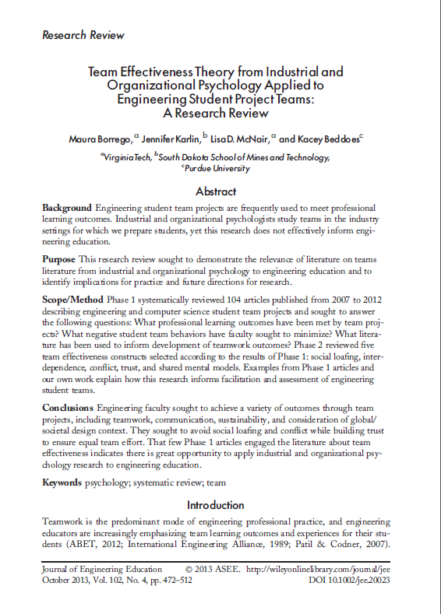
Based on review article in print
Borrego, M., Karlin, J., McNair, L. D., & Beddoes, K. (2013). Team effectiveness theory from industrial and organizational psychology applied to engineering student project teams—A review. Journal of Engineering Education, 102(4), 472–512. doi: 10.1002/jee.20023

Slide 3
Strategies for engineering faculty audience
Know their learning goals and values
Do they need to be convinced of value of teams?
Address their concerns and problems
Highlight data and examples in settings most similar to theirs
Shift thinking to transferable skills
Conflict management, negotiation, trust building
Identify their potential contributions to SciTS
Qualitative, longitudinal, naturalistic

Slide 4
Research questions
What professional skills have engineering and computer science educators sought to develop in engineering and computer science students through team projects?
What challenges in facilitating and assessing engineering and computer science student teams have engineering and computer science educators sought to address?
What literature has been used to inform development of teamwork and related professional skills in engineering and computer science students?

Slide 5
Inclusion criteria for engineering articles
Studied engineering or computer science graduate or undergraduate students
Studied teams working on a specific project
Had at least a practical goal of developing professional skills in students
Evaluated with some effectiveness data from students, broadly defined
Published in English Jan 2007 - Jun 2012

Slide 6
Search procedures: 104 qualifying papers
Databases
Education Research Complete
Academic Search Complete
Psychology and Behavioral Sciences
Business Source Complete
Terms
“engineering,”
“teams”
and “students” in any field
Results were mostly in journals with “engineering education” in the title, with some STEM education, computers

Slide 7
Geographic distribution of authors
Countries with 1 Article
Belgium
Botswana
Canada
Colombia
Finland
France
Mexico
Netherlands
New Zealand
Portugal
Qatar
Serbia
Sweden
Taiwan
Trinidad and Tobago
United Arab Emirates

Slide 8
Relationships and subtypes of teamwork outcomes
Teamwork
Communication
Design
32
8
12
10
3
16
5
Only 18 of 104 articles did not address
teamwork, design or communication

Slide 9
Challenges cited
Social loafing
Conflict
Lack of trust
Organization
Team
Processes
Performance
Individual
Input
Process
Output

Slide 10
Review and examples of five constructs
Construct | Definition
Social Loafing (avoid) | The tendency of individuals to exert less effort when working collectively than when working individually
Interdependence (promote) | The level of reliance one person, group, or organization has on others in order to complete their work
Conflict (avoid, promote conflict management) | Perceived incompatibilities or discrepant views among the parties involved in a project or team
Trust (promote) | Confidence in the ability of others; faith in the trustworthy intentions of others
Shared Mental Models (promote) | Shared knowledge structures that enable a team to form accurate explanations and expectations of the task, to coordinate their actions, and to adapt their behavior

Slide 11
Pedagogical recommendations
Compelling project with inherent value
Small teams
Complex tasks
Clear goals and values
Clarity of project assignment
Discuss conflict as a source of creativity
Training on situational awareness for effectively dealing with different levels of conflict
Minimize monitoring behaviors
Peer evaluation of individual effort
Group grading, Grading that promotes collaboration, Grading requirement to know all aspects of project
Group processing
Time and activities for teams to develop consensus
Class time for team meetings
Balance project workload with other student demands
Teambuilding, e.g., social
Goal setting together in teams

Slide 12
What else can or should we do to promote team science training in more settings?
Address their values, learning goals, concerns and problems
Highlight examples and data in similar settings
Shift thinking to transferable skills
Identify their potential contributions to SciTS

